Slide 1
Component 2:
Combinational Logic
Part 1 – Gate Circuits and Boolean Equations
  Binary Logic and Gates
  Boolean Algebra
  Standard Forms
Part 2 – Circuit Optimization
  Two-Level Optimization
  Map Manipulation
  Multi-Level Circuit Optimization
Part 3 – Additional Gates and Circuits
  Other Gate Types
  Exclusive-OR Operator and Gates
  High-Impedance Outputs
Chapter 2 - Part 1 <number>

Slide 2
Component 2:
Combinational Logic
Part 1 – Gate Circuits and Boolean Equations
  Binary Logic and Gates
  Boolean Algebra
  Standard Forms
Part 2 – Circuit Optimization
  Two-Level Optimization
  Map Manipulation
  Multi-Level Circuit Optimization
Part 3 – Additional Gates and Circuits
  Other Gate Types
  Exclusive-OR Operator and Gates
  High-Impedance Outputs
Chapter 2 - Part 1 <number>

Slide 3
Binary Logic and Gates
Binary variables take on one of two values.
Logical operators operate on binary values and binary variables.
Basic logical operators are the logic functions AND, OR and NOT.
Logic gates implement logic functions.
Boolean Algebra: a useful mathematical system for specifying and transforming logic functions.
We study Boolean algebra as foundation for designing and analyzing digital systems!
Chapter 2 - Part 1 <number>

Slide 4
Binary Variables
Recall that the two binary values have different names:
  True/False
  On/Off
  Yes/No
  1/0
We use 1 and 0 to denote the two values.
Variable identifier examples:
  A, B, y, z, or X₁ for now
  RESET, START_IT, or ADD1 later
Chapter 2 - Part 1 <number>

Slide 5
Logical Operations
The three basic logical operations are:
  AND
  OR
  NOT
AND is denoted by a dot (·).
OR is denoted by a plus (+).
NOT is denoted by an overbar ( ¯ ), a single quote mark (') after, or (~) before the variable.
Chapter 2 - Part 1 <number>

Slide 6
Notation Examples
Examples:
  is read “Y is equal to A AND B.”
  is read “z is equal to x OR y.”
  is read “X is equal to NOT A.”
Y
=
A
⋅
B
z
=
x
+
y
X
=
A
Note: The statement:
  1 + 1 = 2 (read “one plus one equals two”)
is not the same as
  1 + 1 = 1 (read “1 or 1 equals 1”).
Chapter 2 - Part 1 <number>

Slide 7
Operator Definitions
Operations are defined on the values "0" and "1" for each operator:
AND
OR
NOT
0 · 0 = 0
0 + 0 = 0
0
=
1
0 · 1 = 0
0 + 1 = 1
1
=
0
1 · 0 = 0
1 + 0 = 1
1 · 1 = 1
1 + 1 = 1
Chapter 2 - Part 1 <number>

Slide 8
Truth Tables
Truth table − a tabular listing of the values of a function for all possible combinations of values on its arguments
Example: Truth tables for the basic logic operations:
AND
OR
X | Y | Z = X+Y
0 | 0 | 0
0 | 1 | 1
1 | 0 | 1
1 | 1 | 1
NOT
X
Y
Z = X·Y
X
Z
=
X
0
0
0
0
1
0
1
0
1
0
1
0
0
1
1
1
Chapter 2 - Part 1 <number>

Slide 9
Logic Function Implementation
Using Switches
  For inputs:
    logic 1 is switch closed
    logic 0 is switch open
  For outputs:
    logic 1 is light on
    logic 0 is light off.
  NOT uses a switch such
  that:
    logic 1 is switch open
    logic 0 is switch closed
Switches in parallel => OR
Switches in series => AND
Normally-closed switch => NOT
C
Chapter 2 - Part 1 <number>

Slide 10
Logic Function Implementation (Continued)
Example: Logic Using Switches
Light is on (L = 1) for
  L(A, B, C, D) =
  and off (L = 0), otherwise.
B
C
A
D
Chapter 2 - Part 1 <number>
Notes:
L (A, B, C, D) = A ((B C') + D) = A B C' + A D

Slide 11
Logic Gates
In the earliest computers, switches were opened and closed by magnetic fields produced by energizing coils in relays. The switches in turn opened and closed the current paths.
Later, vacuum tubes that open and close current paths electronically replaced relays.
Today, transistors are used as electronic switches that open and close current paths.
Chapter 2 - Part 1 <number>

Slide 12
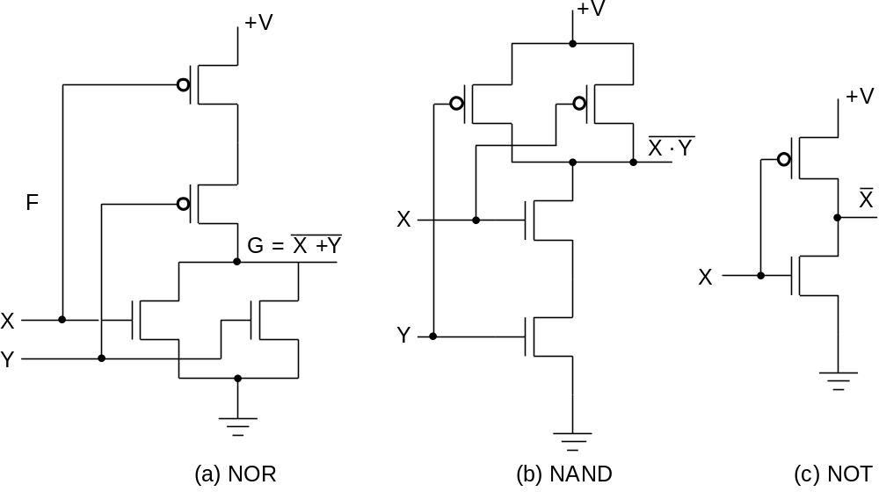
Logic Gates (continued)
Implementation of logic gates with transistors (See Reading Supplement − CMOS Circuits)
Transistor or tube implementations of logic functions are called logic gates or just gates
Transistor gate circuits can be modeled by switch circuits
Chapter 2 - Part 1 <number>
Notes:
The transistor without the “bubble” on its input is an N-type field effect
transistor. It acts like a closed switch between its top and bottom terminals
with an H (1) applied to its input on its left. It acts like an open switch with
an L (0) applied to its input. The transistor with the “bubble” on its input is a
P-type field effect transistor. The +V at the top provides an H (1) and the
Ground symbol at the bottom provides an L (0). By modeling the two types
of field effect transistors as switches, one can see how the series and
parallel interconnections can produce 1’s and 0’s on the outputs on the
right in response to applied 1’s and 0’s on the inputs on the left. NOR and
NAND are OR and AND, each followed by a NOT respectively.

Slide 13
Logic Gate Symbols and Behavior
Logic gates have special symbols:
And waveform behavior in time as follows:
X
X
Z
=
X
·
Y
Z
=
X
+
Y
X
Z
=
X
Y
Y
AND gate
OR gate
NOT gate or
inverter
(a) Graphic symbols
X
0
0
1
1
Y
0
1
0
1
(AND)
X
·
Y
0
0
0
1
(OR)
X
+
Y
0
1
1
1
(NOT)
X
1
1
0
0
(b) Timing diagram
Chapter 2 - Part 1 <number>

Slide 14
Logic Diagrams and Expressions
Truth Table
Equation
X Y Z
F
=
X
+
Y
⋅
Z
0 0 0
0
F
=
X
+
Y
Z
0 0 1
1
0 1 0
0
Logic Diagram
0 1 1
0
X
1 0 0
1
1 0 1
1
Y
F
1 1 0
1
Z
1 1 1
1
Boolean equations, truth tables and logic diagrams describe the same function!
Truth tables are unique; expressions and logic diagrams are not. This gives flexibility in implementing functions.
Chapter 2 - Part 1 <number>

Slide 15
Boolean Algebra
An algebraic structure defined on a set of at least two elements, B, together with three binary operators (denoted +, · and ) that satisfies the following basic identities:
1.
X
+ 0
=
X
2.
X
. 1
=
X
3.
X
1
1
4.
X
. 0
0
+
=
=
5.
X + X
=
X
6.
X . X
=
X
7.
X + X
=
1
8.
X . X
=
0
9.
X = X
10.
X + Y
=
Y + X
11.
XY
=
YX
Commutative
12.
(X + Y)
+
Z
=
X + (Y
+
Z)
13.
(XY)
Z
=
X(Y
Z)
Associative
14.
X(Y +
Z)
=
XY
+
XZ
15.
X
+ YZ
=
(X + Y)
(X + Z)
Distributive
DeMorgan
16.
X + Y
=
X . Y
17.
X . Y
=
X + Y
’
s
Chapter 2 - Part 1 <number>

Slide 16
Some Properties of Identities & the Algebra
If the meaning is unambiguous, we leave out the symbol “·”
The identities above are organized into pairs. These pairs have names as follows:
1-4 Existence of 0 and 1 5-6 Idempotence
7-8 Existence of complement 9 Involution
10-11 Commutative Laws 12-13 Associative Laws
14-15 Distributive Laws 16-17 DeMorgan’s Laws
The dual of an algebraic expression is obtained by interchanging + and · and interchanging 0’s and 1’s.
The identities appear in dual pairs. When there is only one identity on a line the identity is self-dual, i. e., the dual expression = the original expression.
Chapter 2 - Part 1 <number>

Slide 17
Some Properties of Identities & the Algebra (Continued)
Unless it happens to be self-dual, the dual of an expression does not equal the expression itself.
Example: F = (A + C) · B + 0
dual F = (A · C + B) · 1 = A · C + B
Example: G = X · Y + (W + Z)
dual G =
Example: H = A · B + A · C + B · C
dual H =
Are any of these functions self-dual?
Chapter 2 - Part 1 <number>
Notes:
Dual G = ((X+Y) · (W · Z)') = ((X+Y) ·(W' + Z')
Dual H = (A + B)(A + C)(B + C). Using the Boolean identities,
= (A +BC) (B+C) = AB + AC + BC. So H is self-dual.

Slide 18
Boolean Operator Precedence
The order of evaluation in a Boolean
expression is:
1.
Parentheses
2.
NOT
3.
AND
4.
OR
Consequence: Parentheses appear
around OR expressions
Example: F = A(B + C)(C + D)
Chapter 2 - Part 1 <number>

Slide 19
Example 1: Boolean Algebraic Proof
A + A·B = A (Absorption Theorem)
Proof Steps Justification (identity or theorem)
A + A·B
= A · 1 + A · B X = X · 1
= A · ( 1 + B) X · Y + X · Z = X ·(Y + Z)(Distributive Law)
= A · 1 1 + X = 1
= A X · 1 = X
Our primary reason for doing proofs is to learn:
  Careful and efficient use of the identities and theorems of Boolean algebra, and
  How to choose the appropriate identity or theorem to apply to make forward progress, irrespective of the application.
Chapter 2 - Part 1 <number>

Slide 20
Example 2: Boolean Algebraic Proofs
AB + AC + BC = AB + AC (Consensus Theorem)
Proof Steps Justification (identity or theorem)
AB + AC + BC
= AB + AC + 1 · BC ?
= AB +AC + (A + A) · BC ?
=
Chapter 2 - Part 1 <number>
Notes:
Justification 1: 1 . X = X
Justification 2: X + X’ = 1
= AB + A’C + ABC + A’BC X(Y + Z) = XY + XZ (Distributive Law)
= AB + ABC + A’C + A’BC X + Y = Y + X (Commutative Law)
= AB . 1 + ABC + A’C . 1 + A’C . B X . 1 = X, X . Y = Y . X (Commutative Law)
= AB (1 + C) + A’C (1 + B) X(Y + Z) = XY +XZ (Distributive Law)
= AB . 1 + A’C . 1 = AB + A’C X . 1 = X

Slide 21
Example 3: Boolean Algebraic Proofs
Proof Steps Justification (identity or theorem)
=
(
X
+
Y
)
Z
+
X
Y
=
Y
(
X
+
Z
)
(
X
+
Y
)
Z
+
X
Y
Chapter 2 - Part 1 <number>
Notes:
= X’ Y’ Z + X Y’ (A + B)’ = A’ . B’ (DeMorgan’s Law)
= Y’ X’ Z + Y’ X A . B = B . A (Commutative Law)
= Y’ (X’ Z + X) A(B + C) = AB + AC (Distributive Law)
= Y’ (X’ + X)(Z + X) A + BC = (A + B)(A + C) (Distributive Law)
= Y’ . 1 . (Z + X) A + A’ = 1
= Y’ (X + Z) 1 . A = A, A + B = B + A (Commutative Law)

Slide 22
Useful Theorems
(
)
(
)
x
⋅
y
+
x
⋅
y
=
y
x
+
y
x
+
y
=
y
M
inimizatio
n
(
)
x
+
x
y
=
x
+
y
x
⋅
x
+
y
=
x
y
Simplifica
tion
⋅
⋅
x
⋅
y
+
x
⋅
z
+
y
⋅
z
=
x
⋅
y
+
x
⋅
z
Consensus
(
)
(
)
(
)
(
)
(
)
x
+
y
⋅
x
+
z
⋅
y
+
z
=
x
+
y
⋅
x
+
z
x
+
y
=
x
⋅
y
x
⋅
y
=
x
+
y
DeMorgan'
s
Laws
Chapter 2 - Part 1 <number>

Slide 23
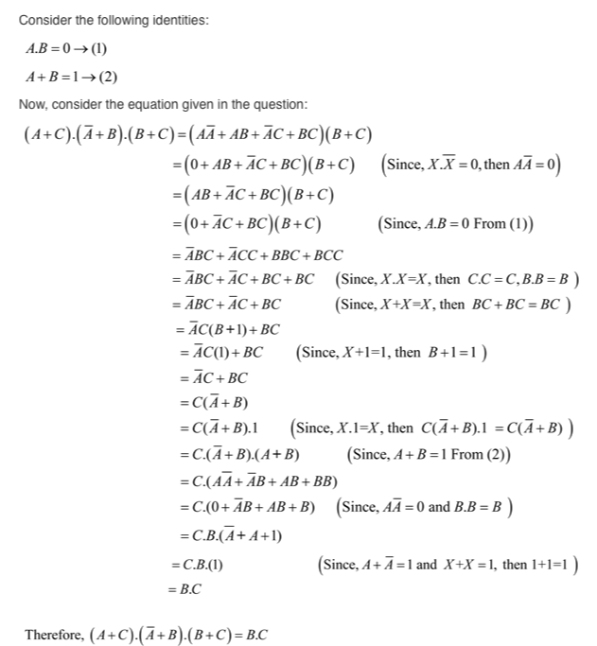

Example
Chapter 2 - Part 1 <number>

Slide 24
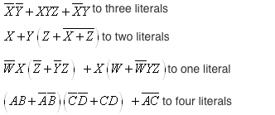
Example
Chapter 2 - Part 1 <number>

Slide 25
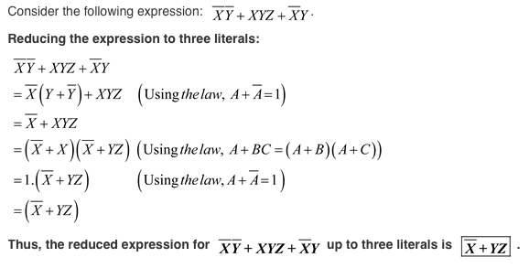

Slide 26
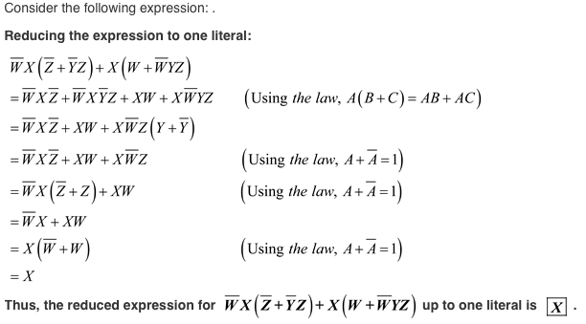

Slide 27
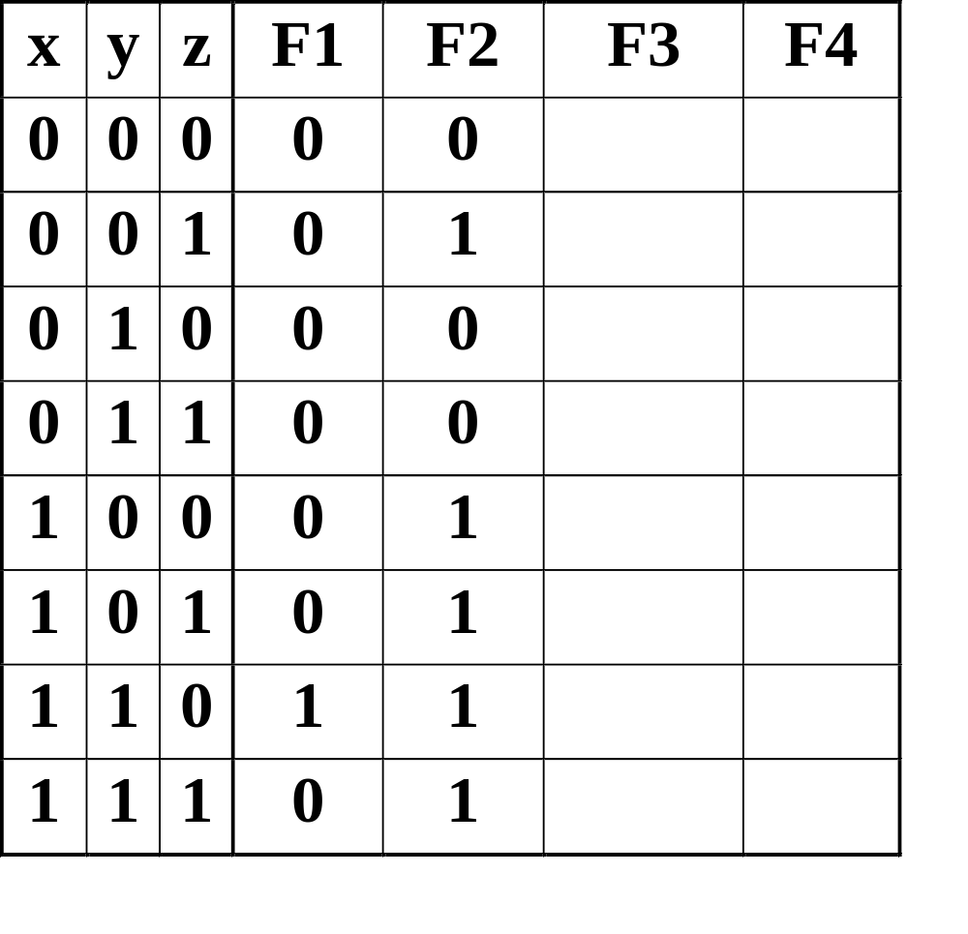
Boolean Function Evaluation
F1
=
xy
z
F2
=
x
+
y
z
F3
=
x
y
z
+
x
y
z
+
x
y
F4
=
x
y
+
x
z
Chapter 2 - Part 1 <number>
Notes:
F3 is 1 for x’y’z’, x’yz, xy’z’ and xy’z => F3 = 1,0,0,1,1,1,0,0
F4 is 1 for xy’z’, xy’z, x’y’z and x’y z => F4 = 0,1,0,1,1,1,0,0

Slide 28
Expression Simplification
An application of Boolean algebra
Simplify to contain the smallest number of literals (complemented and uncomplemented variables):
= AB + ABCD + A C D + A C D + A B D
= AB + AB(CD) + A C (D + D) + A B D
= AB + A C + A B D = B(A + AD) +AC
= B (A + D) + A C 5 literals
A
B
+
A
C
D
+
A
B
D
+
A
C
D
+
A
B
C
D
Chapter 2 - Part 1 <number>

Slide 29
Complementing Functions
Use DeMorgan's Theorem to complement a function:
  1. Interchange AND and OR operators
  2. Complement each constant value and literal
Example: Complement F =
F = (x + y + z)(x + y + z)
Example: Complement G = (a + bc)d + e
G =
x
y
z
+
x
y
z
Chapter 2 - Part 1 <number>

Slide 30
Overview – Canonical Forms
What are Canonical Forms?
Minterms and Maxterms
Index Representation of Minterms and Maxterms
Sum-of-Minterm (SOM) Representations
Product-of-Maxterm (POM) Representations
Representation of Complements of Functions
Conversions between Representations
Chapter 2 - Part 1 <number>

Slide 31
Canonical Forms
It is useful to specify Boolean functions in a form that:
  Allows comparison for equality.
  Has a correspondence to the truth tables
Canonical Forms in common usage:
  Sum of Minterms (SOM)
  Product of Maxterms (POM)
Chapter 2 - Part 1 <number>

Slide 32
Minterms
Minterms are AND terms with every variable present in either true or complemented form.
Given that each binary variable may appear normal (e.g., x) or complemented (e.g., ), there are 2^{n} minterms for n variables.
Example: Two variables (X and Y)produce
2 x 2 = 4 combinations:
  (both normal)
  (X normal, Y complemented)
  (X complemented, Y normal)
  (both complemented)
Thus there are four minterms of two variables.
x
XY
X
Y
X
Y
X
Y
Chapter 2 - Part 1 <number>

Slide 33
Maxterms
Maxterms are OR terms with every variable in true or complemented form.
Given that each binary variable may appear normal (e.g., x) or complemented (e.g., x), there are 2^{n} maxterms for n variables.
Example: Two variables (X and Y) produce
2 x 2 = 4 combinations:
  (both normal)
  (x normal, y complemented)
  (x complemented, y normal)
  (both complemented)
X
+
Y
X
+
Y
X
+
Y
X
+
Y
Chapter 2 - Part 1 <number>

Slide 34
Maxterms and Minterms
Examples: Two variable minterms and maxterms.
The index above is important for describing which variables in the terms are true and which are complemented.
Index | Minterm | Maxterm
0 | x y | x + y
1 | x y | x + y
2 | x y | x + y
3 | x y | x + y
Chapter 2 - Part 1 <number>

Slide 35
Standard Order
Minterms and maxterms are designated with a subscript
The subscript is a number, corresponding to a binary pattern
The bits in the pattern represent the complemented or normal state of each variable listed in a standard order.
All variables will be present in a minterm or maxterm and will be listed in the same order (usually alphabetically)
Example: For variables a, b, c:
  Maxterms: (a + b + c), (a + b + c)
  Terms: (b + a + c), a c b, and (c + b + a) are NOT in standard order.
  Minterms: a b c, a b c, a b c
  Terms: (a + c), b c, and (a + b) do not contain all variables
Chapter 2 - Part 1 <number>

Slide 36
Purpose of the Index
The index for the minterm or maxterm, expressed as a binary number, is used to determine whether the variable is shown in the true form or complemented form.
For Minterms:
  “1” means the variable is “Not Complemented” and
  “0” means the variable is “Complemented”.
For Maxterms:
  “0” means the variable is “Not Complemented” and
  “1” means the variable is “Complemented”.
Chapter 2 - Part 1 <number>

Slide 37
Index Example in Three Variables
Example: (for three variables)
Assume the variables are called X, Y, and Z.
The standard order is X, then Y, then Z.
The Index 0 (base 10) = 000 (base 2) for three variables). All three variables are complemented for minterm 0 ( ) and no variables are complemented for Maxterm 0 (X,Y,Z).
  Minterm 0, called m₀ is .
  Maxterm 0, called M₀ is (X + Y + Z).
  Minterm 6 ?
  Maxterm 6 ?
X
,
Y
,
Z
X
Y
Z
Chapter 2 - Part 1 <number>
Notes:
m6 = X Y Z’
M6 = (X’ + Y’ + Z)

Slide 38


Index Examples – Four Variables
Index Binary Minterm Maxterm
i Pattern m_{i} M_{i}
0 0000
1 0001
3 0011
5 0101
7 0111
10 1010
13 1101
15 1111
a
b
c
d
a
b
c
d
?
?
a
+
b
+
c
+
d
a
b
c
d
a
+
b
+
c
+
d
?
a
+
b
+
c
+
d
a
b
c
d
a
+
b
+
c
+
d
a
b
c
d
?
a
+
b
+
c
+
d
Chapter 2 - Part 1 <number>
Notes:
M1 = a + b + c + d’
m3 = a’ b’ c d
m7 = a’ b c d
M 13 = a’ + b’ + c + d’

Slide 39
Minterm and Maxterm Relationship
Review: DeMorgan's Theorem
and
Two-variable example:
and
Thus M₂ is the complement of m₂ and vice-versa.
Since DeMorgan's Theorem holds for n variables, the above holds for terms of n variables
giving:
and
Thus M_{i} is the complement of m_{i}.
x
·
y
=
x
+
y
x
+
y
=
x
⋅
y
M
=
x
+
y
m
=
x·
y
2
2
M
=
m
m
=
M
i
i
i
i
Chapter 2 - Part 1 <number>

Slide 40
Function Tables for Both
Minterms of Maxterms of
2 variables 2 variables
Each column in the maxterm function table is the complement of the column in the minterm function table since M_{i} is the complement of m_{i}.
x y
m
m
m
m
x y
M
M
M
M
0
1
2
3
0
1
2
3
0 0
1
0
0
0
0 0
0
1
1
1
0 1
0
1
0
0
0 1
1
0
1
1
1 0
0
0
1
0
1 0
1
1
0
1
1 1
0
0
0
1
1 1
1
1
1
0
Chapter 2 - Part 1 <number>

Slide 41
Observations
In the function tables:
  Each minterm has one and only one 1 present in the 2^{n} terms (a minimum of 1s). All other entries are 0.
  Each maxterm has one and only one 0 present in the 2^{n} terms All other entries are 1 (a maximum of 1s).
We can implement any function by "ORing" the minterms corresponding to "1" entries in the function table. These are called the minterms of the function.
We can implement any function by "ANDing" the maxterms corresponding to "0" entries in the function table. These are called the maxterms of the function.
This gives us two canonical forms:
  Sum of Minterms (SOM)
  Product of Maxterms (POM)
for stating any Boolean function.
Chapter 2 - Part 1 <number>

Slide 42
Minterm Function Example
Example: Find F₁ = m₁ + m₄ + m₇
F1 = x y z + x y z + x y z
x y z
index
m₁
+
m₄
+
m₇
= F₁
0 0 0
0
0
+
0
+
0
= 0
0 0 1
1
1
+
0
+
0
= 1
0 1 0
2
0
+
0
+
0
= 0
0 1 1
3
0
+
0
+
0
= 0
1 0 0
4
0
+
1
+
0
= 1
1 0 1
5
0
+
0
+
0
= 0
1 1 0
6
0
+
0
+
0
= 0
1 1 1
7
0
+
0
+
1
= 1
Chapter 2 - Part 1 <number>

Slide 43
Minterm Function Example
F(A, B, C, D, E) = m₂ + m₉ + m₁₇ + m₂₃
F(A, B, C, D, E) =
Chapter 2 - Part 1 <number>
Notes:
F(A,B,C,D,E) = A’B’C’DE’ + A’BC’D’E + AB’C’D’E + AB’CDE

Slide 44
Maxterm Function Example
Example: Implement F1 in maxterms:
F₁ = M₀ · M₂ · M₃ · M₅ · M₆
F
=
(x
+
y
+
z)
·(x
+
y
+
z)·(x
+
y
+
z
)
1
·(
x
+
y
+
z
)·(
x
+
y
+
z)
x y z
i
M₀
⋅
M₂
⋅
M₃
⋅
M₅
⋅
M₆
= F1
0 0 0
0
0
⋅
1
⋅
1
⋅
1
⋅
1
= 0
0 0 1
1
1
⋅
1
⋅
1
⋅
1
⋅
1
= 1
0 1 0
2
1
⋅
0
⋅
1
⋅
1
⋅
1
= 0
0 1 1
3
1
⋅
1
⋅
0
⋅
1
⋅
1
= 0
1 0 0
4
1
⋅
1
⋅
1
⋅
1
⋅
1
= 1
1 0 1
5
1
⋅
1
⋅
1
⋅
0
⋅
1
= 0
1 1 0
6
1
⋅
1
⋅
1
⋅
1
⋅
0
= 0
1 1 1
7
1
⋅
1
⋅
1
⋅
1
⋅
1
= 1
Chapter 2 - Part 1 <number>

Slide 45
Maxterm Function Example
F(A, B,C,D) =
F
(
A
,
B
,
C
,
D
)
=
M
⋅
M
⋅
M
⋅
M
3
8
11
14
Chapter 2 - Part 1 <number>
Notes:
F = (A + B + C’ + D’) (A’ + B + C + D) (A’ + B + C’ + D’) (A’ + B’ + C’ + D)

Slide 46
Canonical Sum of Minterms
Any Boolean function can be expressed as a Sum of Minterms.
  For the function table, the minterms used are the terms corresponding to the 1's
  For expressions, expand all terms first to explicitly list all minterms. Do this by “ANDing” any term missing a variable v with a term ( ).
Example: Implement as a sum of minterms.
  First expand terms:
  Then distribute terms:
  Express as sum of minterms: f = m₃ + m₂ + m₀
v
+
v
f
=
x
+
x
y
f
=
x
(
y
+
y
)
+
x
y
f
=
xy
+
x
y
+
x
y
Chapter 2 - Part 1 <number>

Slide 47
Another SOM Example
F
=
A
+
B
C
Example:
There are three variables, A, B, and C which we take to be the standard order.
Expanding the terms with missing variables:
Collect terms (removing all but one of duplicate terms):
Express as SOM:
Chapter 2 - Part 1 <number>
Notes:
F = A(B + B’)(C + C’) + (A + A’) B’ C
= ABC + ABC’ + AB’C + AB’C’ + AB’C + A’B’C
= ABC + ABC’ + AB’C + AB’C’ + A’B’C
= m7 + m6 + m5 + m4 + m1 = m1 + m4 + m5 + m6 + m7

Slide 48
Shorthand SOM Form
From the previous example, we started with:
We ended up with:
F = m₁+m₄+m₅+m₆+m₇
This can be denoted in the formal shorthand:
Note that we explicitly show the standard variables in order and drop the “m” designators.
F
=
A
+
B
C
Chapter 2 - Part 1 <number>

Slide 49
Canonical Product of Maxterms
Any Boolean Function can be expressed as a Product of Maxterms (POM).
  For the function table, the maxterms used are the terms corresponding to the 0's.
  For an expression, expand all terms first to explicitly list all maxterms. Do this by first applying the second distributive law , “ORing” terms missing variable v with a term equal to and then applying the distributive law again.
Example: Convert to product of maxterms:
  Apply the distributive law:
  Add missing variable z:
  Express as POM: f = M₂ · M₃
v
⋅
v
f
(
x
,
y
,
z
)
=
x
+
x
y
x
+
x
y
=
(x
+
x
)(x
+
y
)
=
1
⋅
(x
+
y
)
=
x
+
y
x
+
y
+
z
⋅
z
=
(
x
+
y
+
z
)
(
x
+
y
+
z
)
Chapter 2 - Part 1 <number>

Slide 50
Another POM Example
Convert to Product of Maxterms:
Use x + y z = (x+y)·(x+z) with , and to get:
Then use to get:
and a second time to get:
Rearrange to standard order,
to give f = M₅ · M₂
f(A,
B,
C)
=
A
C
+
B
C
+
A
B
x
=
(A
C
+
B
C),
y
=
A
z
=
B
f
=
(A
C
+
B
C
+
A
)(A
C
+
B
C
+
B
)
x
+
x
y
=
x
+
y
f
=
(
C
+
BC
+
A
)(A
C
+
C
+
B
)
f
=
(
C
+
B
+
A
)(A
+
C
+
B
)
f
=
(
A
+
B
+
C
)(A
+
B
+
C)
Chapter 2 - Part 1 <number>

Slide 51
Function Complements
The complement of a function expressed as a sum of minterms is constructed by selecting the minterms missing in the sum-of-minterms canonical forms.
Alternatively, the complement of a function expressed by a Sum of Minterms form is simply the Product of Maxterms with the same indices.
Example: Given
F
(
x
,
y
,
z
)
=
Σ
(
1
,
3
,
5
,
7
)
m
F
(
x
,
y
,
z
)
=
Σ
(
0
,
2
,
4
,
6
)
m
F
(
x
,
y
,
z
)
=
Π
(
1
,
3
,
5
,
7
)
M
Chapter 2 - Part 1 <number>

Slide 52


Conversion Between Forms
To convert between sum-of-minterms and product-of-maxterms form (or vice-versa) we follow these steps:
  Find the function complement by swapping terms in the list with terms not in the list.
  Change from products to sums, or vice versa.
Example:Given F as before:
Form the Complement:
Then use the other form with the same indices – this
forms the complement again, giving the other form of the original function:
F
(
x
,
y
,
z
)
=
Σ
(
0
,
2
,
4
,
6
)
m
Chapter 2 - Part 1 <number>

Slide 53
Standard Forms
Standard Sum-of-Products (SOP) form: equations are written as an OR of AND terms
Standard Product-of-Sums (POS) form: equations are written as an AND of OR terms
Examples:
  SOP:
  POS:
These “mixed” forms are neither SOP nor POS
A
B
C
+
A
B
C
+
B
(A
+
B)
·
(A
+
B
+
C
)
·
C
(A
B
+
C)
(A
+
C)
A
B
C
+
A
C
(A
+
B)
Chapter 2 - Part 1 <number>

Slide 54
Standard Sum-of-Products (SOP)
A sum of minterms form for n variables can be written down directly from a truth table.
  Implementation of this form is a two-level network of gates such that:
  The first level consists of n-input AND gates, and
  The second level is a single OR gate (with fewer than 2^{n} inputs).
This form often can be simplified so that the corresponding circuit is simpler.
Chapter 2 - Part 1 <number>

Slide 55
Standard Sum-of-Products (SOP)
A Simplification Example:
Writing the minterm expression:
F = A B C + A B C + A B C + ABC + ABC
Simplifying:
F =
Simplified F contains 3 literals compared to 15 in minterm F
Chapter 2 - Part 1 <number>
Notes:
F = A’ B’ C + A (B’ C’ + B C’ + B’ C + B C)
= A’ B’ C + A (B’ + B) (C’ + C)
= A’ B’ C + A.1.1
= A’ B’ C + A
= B’C + A

Slide 56
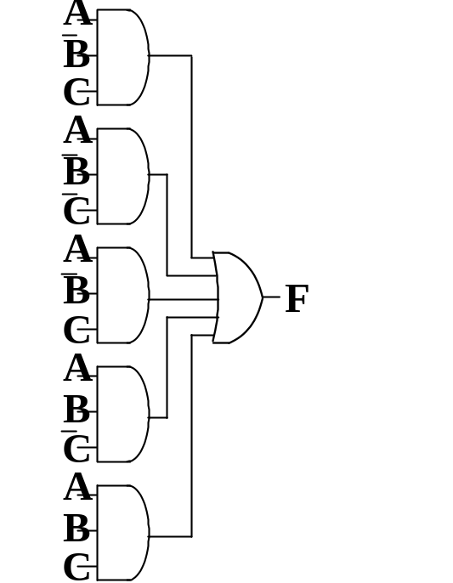
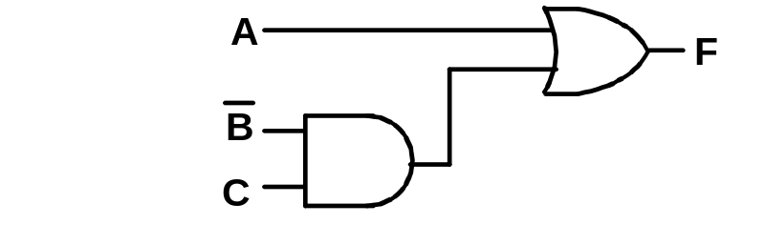
AND/OR Two-level Implementation of SOP Expression
The two implementations for F are shown below – it is quite apparent which is simpler!
Chapter 2 - Part 1 <number>

Slide 57
SOP and POS Observations
The previous examples show that:
  Canonical Forms (Sum-of-minterms, Product-of-Maxterms), or other standard forms (SOP, POS) differ in complexity
  Boolean algebra can be used to manipulate equations into simpler forms.
  Simpler equations lead to simpler two-level implementations
Questions:
  How can we attain a “simplest” expression?
  Is there only one minimum cost circuit?
  The next part will deal with these issues.
Chapter 2 - Part 1 <number>

Slide 58
Component 2:
Combinational Logic
Part 1 – Gate Circuits and Boolean Equations
  Binary Logic and Gates
  Boolean Algebra
  Standard Forms
Part 2 – Circuit Optimization
  Two-Level Optimization
  Map Manipulation
  Multi-Level Circuit Optimization
Part 3 – Additional Gates and Circuits
  Other Gate Types
  Exclusive-OR Operator and Gates
  High-Impedance Outputs
Chapter 2 - Part 1 <number>

Slide 59
Circuit Optimization
Goal: To obtain the simplest implementation for a given function
Optimization is a more formal approach to simplification that is performed using a specific procedure or algorithm
Optimization requires a cost criterion to measure the simplicity of a circuit
Two distinct cost criteria we will use:
  Literal cost (L)
  Gate input cost (G)
  Gate input cost with NOTs (GN)
Chapter 2 - Part 2 <number>

Slide 60
Literal Cost
Literal – a variable or it complement
Literal cost – the number of literal appearances in a Boolean expression corresponding to the logic circuit diagram
Examples:
  F = BD + A C + A L = 8
  F = BD + A C + A + AB L =
  F = (A + B)(A + D)(B + C + )( + + D) L =
  Which solution is best?
B
C
D
D
C
B
B
D
B
C
Chapter 2 - Part 2 <number>
Notes:
2nd Literal Cost = 11
3rd Literal Cost = 10
The first solution is best

Slide 61
Gate Input Cost
Gate input costs - the number of inputs to the gates in the implementation corresponding exactly to the given equation or equations. (G - inverters not counted, GN - inverters counted)
For SOP and POS equations, it can be found from the equation(s) by finding the sum of:
  all literal appearances
  the number of terms excluding terms consisting only of a single literal,(G) and
  optionally, the number of distinct complemented single literals (GN).
Example:
  F = BD + A C + A G = 11, GN = 14
  F = BD + A C + A + AB G = , GN =
  F = (A + )(A + D)(B + C + )( + + D) G = , GN =
  Which solution is best?
B
C
D
D
C
B
B
B
D
B
C
Chapter 2 - Part 2 <number>
Notes:
G = 15, GN = 18 (second value includes inverter inputs)
G = 14, GN = 17
1st solution is best

Slide 62
Cost Criteria (continued)
GN = G + 2 = 9
Example 1:
F = A + B C +
L = 5
C
B
G = L + 2 = 7
B
C
A
F
L (literal count) counts the AND inputs and the single
literal OR input.
G (gate input count) adds the remaining OR gate inputs
GN(gate input count with NOTs) adds the inverter inputs
Chapter 2 - Part 2 <number>

Slide 63
Cost Criteria (continued)
A
Example 2:
F = A B C +
L = 6 G = 8 GN = 11
F = (A + )( + C)( + B)
L = 6 G = 9 GN = 12
Same function and same
literal cost
But first circuit has better
gate input count and better
gate input count with NOTs
Select it!
B
C
B
A
C
F
C
B
A
A
B
C
F
Chapter 2 - Part 2 <number>

Slide 64
Boolean Function Optimization
Minimizing the gate input (or literal) cost of a (a set of) Boolean equation(s) reduces circuit cost.
We choose gate input cost.
Boolean Algebra and graphical techniques are tools to minimize cost criteria values.
Some important questions:
  When do we stop trying to reduce the cost?
  Do we know when we have a minimum cost?
Treat optimum or near-optimum cost functions
for two-level (SOP and POS) circuits first.
Introduce a graphical technique using Karnaugh maps (K-maps, for short)
Chapter 2 - Part 2 <number>

Slide 65
Karnaugh Maps (K-map)
A K-map is a collection of squares
  Each square represents a minterm/maxterm
  The collection of squares is a graphical representation of a Boolean function
  Adjacent squares differ in the value of one variable
  Alternative algebraic expressions for the same function are derived by recognizing patterns of squares
The K-map can be viewed as
  A reorganized version of the truth table
  A topologically-warped Venn diagram as used to visualize sets in algebra of sets
Chapter 2 - Part 2 <number>

Slide 66
Some Uses of K-Maps
Finding optimum or near optimum
    SOP and POS standard forms, and
    two-level AND/OR and OR/AND circuit implementations
  for functions with small numbers of variables
Chapter 2 - Part 2 <number>

Slide 67
Two Variable Maps
A 2-variable Karnaugh Map:
  Note that minterm m0 and
  minterm m1 are “adjacent”
  and differ in the value of the
  variable y
  Similarly, minterm m0 and
  minterm m2 differ in the x variable.
  Also, m1 and m3 differ in the x variable as well.
  Finally, m2 and m3 differ in the value of the variable y
y = 0
y = 1
m
₀ =
m
₁ =
x = 0
x
y
x
y
x = 1
m
₂ =
m
₃ =
x
y
x
y
Chapter 2 - Part 2 <number>

Slide 68
K-Map and Truth Tables
The K-Map is just a different form of the truth table.
Example – Two variable function:
  We choose a,b,c and d from the set {0,1} to implement a particular function, F(x,y).
Function Table
K-Map
Input
Function
Values
Value
y = 0
y = 1
(x,y)
F(x,y)
x = 0
a
b
0 0
a
0 1
b
x = 1
c
d
1 0
c
1 1
d
Chapter 2 - Part 2 <number>

Slide 69
K-Map Function Representation
Example: F(x,y) = x
For function F(x,y), the two adjacent cells containing 1’s can be combined using the Minimization Theorem:
Do the same for combining 0’s
F = x
y = 0
y = 1
x = 0
0
0
x = 1
1
1
F
(
x
,
y
)
=
x
y
+
x
y
=
x
Chapter 2 - Part 2 <number>

Slide 70
K-Map Function Representation
Example: G(x,y) = x + y
For G(x,y), two pairs of adjacent cells containing 1’s can be combined using the Minimization Theorem:
G = x+y
y = 0
y = 1
x = 0
0
1
x = 1
1
1
(
)
(
)
G
(
x
,
y
)
=
x
y
+
x
y
+
xy
+
x
y
=
x
+
y
Duplicate x y
Chapter 2 - Part 2 <number>

Slide 71
Three Variable Maps
A three-variable K-map:
Where each minterm corresponds to the product terms:
Note that if the binary value for an index differs in one bit position, the minterms are adjacent on the K-Map
yz=00
yz=01
yz=11
yz=10
x=0
m₀
m₁
m₃
m₂
x=1
m₄
m₅
m₇
m₆
yz=00
yz=01
yz=11
yz=10
x=0
x
y
z
x
y
z
x
y
z
x
y
z
x=1
x
y
z
x
y
z
x
y
z
x
y
z
Chapter 2 - Part 2 <number>

Slide 72
Alternative Map Labeling
Map use largely involves:
  Entering values into the map, and
  Reading off product terms from the map.
Alternate labelings are useful:
y
y z
y
y
x
00
01
11
10
x
0
1
3
2
0
0
1
3
2
x
4
5
7
6
x
1
4
5
7
6
z
z
z
z
Chapter 2 - Part 2 <number>

Slide 73


Example Functions
By convention, we represent the minterms of F by a "1" in the map and leave the minterms of blank
Example:
Example:
Learn the locations of the 8
indices based on the variable
order shown (x, most significant
and z, least significant) on the
map boundaries
F
y
0
3
1
1
1
2
x
4
7
6
1
5
1
z
y
0
1
3
2
1
x
4
7
1
5
1
6
1
z
Chapter 2 - Part 2 <number>

Slide 74
Combining Squares
By combining squares, we reduce number of literals in a product term, reducing the literal cost, thereby reducing the other two cost criteria
On a 3-variable K-Map:
  One square represents a minterm with three variables
  Two adjacent squares represent a product term with two variables
  Four “adjacent” terms represent a product term with one variable
  Eight “adjacent” terms is the function of all ones (no variables) = 1.
Chapter 2 - Part 2 <number>

Slide 75

Example: Combining Squares
y
Example: Let
Applying the Minimization Theorem three times:
Thus the four terms that form a 2 × 2 square correspond to the term "y".
0
3
2
1
1
1
x
4
5
7
6
1
1
z
F
(
x
,
y
,
z
)
=
x
y
z
+
x
y
z
+
x
y
z
+
x
y
z
=
yz
+
y
z
=
y
Chapter 2 - Part 2 <number>

Slide 76
Three-Variable Maps
Reduced literal product terms for SOP standard forms correspond to rectangles on K-maps containing cell counts that are powers of 2.
Rectangles of 2 cells represent 2 adjacent minterms; of 4 cells represent 4 minterms that form a “pairwise adjacent” ring.
Rectangles can contain non-adjacent cells by considering the K-map “wrapped around”
Chapter 2 - Part 2 <number>

Slide 77
Three-Variable Maps
Example Shapes of 2-cell Rectangles:
Read off the product terms for the rectangles shown
y
0
1
3
2
x
4
5
7
6
z
Chapter 2 - Part 2 <number>

Slide 78
Three-Variable Maps
Example Shapes of 4-cell Rectangles:
Read off the product terms for the rectangles shown
y
0
1
3
2
x
4
5
7
6
z
Chapter 2 - Part 2 <number>

Slide 79

Three Variable Maps
K-Maps can be used to simplify Boolean functions by
systematic methods. Terms are selected to cover the
“1s”in the map.
Example: Simplify
z
x
y
y
1
1
1
x
1
1
z
F(x,
y,
z)
=
z
+
x
y
Chapter 2 - Part 2 <number>

Slide 80
Three-Variable Map Simplification
Use a K-map to find an optimum SOP equation for
Chapter 2 - Part 2 <number>
Notes:
F = Z’ + X’ Y’ + X Y

Slide 81
Four Variable Maps
Map and location of minterms:
Y
0
1
3
2
4
5
7
6
12
15
14
X
Variable Order
13
W
8
9
11
10
Z
Chapter 2 - Part 2 <number>

Slide 82
Four Variable Terms
Four variable maps can have rectangles corresponding to:
  A single 1 = 4 variables, (i.e. Minterm)
  Two 1s = 3 variables,
  Four 1s = 2 variables
  Eight 1s = 1 variable,
  Sixteen 1s = zero variables (i.e.
  Constant "1")
Chapter 2 - Part 2 <number>

Slide 83
Four-Variable Maps
Example Shapes of Rectangles:
Y
0
1
3
2
4
5
7
6
12
13
15
14
X
W
8
9
11
10
Z
Chapter 2 - Part 2 <number>

Slide 84
Four-Variable Maps
Example Shapes of Rectangles:
Y
0
1
3
2
4
5
7
6
X
12
13
15
14
W
8
9
11
10
Z
Chapter 2 - Part 2 <number>

Slide 85
Four-Variable Map Simplification
F(W,
X,
Y,
Z)
=
Σ
(0,
2,4,5,6,7,
8,10,13,15
)
m
Chapter 2 - Part 2 <number>
Notes:
F = XZ + X'Z'

Slide 86
Four-Variable Map Simplification
F(W,
X,
Y,
Z)
=
Σ
(3,4,5,7,9,1
3,14,15
)
m
Chapter 2 - Part 2 <number>
Notes:
F = W' X Y' + W' Y Z + WXY + WY'Z

Slide 87
Systematic Simplification
A Prime Implicant is a product term obtained by combining the maximum possible number of adjacent squares in the map into a rectangle with the number of squares a power of 2.
A prime implicant is called an Essential Prime Implicant if it is the only prime implicant that covers (includes) one or more minterms.
Prime Implicants and Essential Prime Implicants can be determined by inspection of a K-Map.
A set of prime implicants "covers all minterms" if, for each minterm of the function, at least one prime implicant in the set of prime implicants includes the minterm.
Chapter 2 - Part 2 <number>

Slide 88
Example of Prime Implicants
Find ALL Prime Implicants
CD
ESSENTIAL Prime Implicants
C
C
B
D
B
D
1
1
1
1
1
1
BD
1
1
BD
1
1
B
B
1
1
1
1
A
A
1
1
1
1
1
1
1
1
A
B
D
D
AD
Minterms covered by single prime implicant
B
C
Chapter 2 - Part 2 <number>

Slide 89
Prime Implicant Practice
Find all prime implicants for:
Chapter 2 - Part 2 <number>
Notes:
Prime implicants are: A, B'C, and B'D'

Slide 90
Another Example
Find all prime implicants for:
  Hint: There are seven prime implicants!
Chapter 2 - Part 2 <number>
Notes:
Prime Implicants are AB, B C' D', A' C' D', A' B' D', A' B' C, A' C D, B C D.

Slide 91
Five Variable or More K-Maps
For five variable problems, we use two adjacent K-maps. It becomes harder to visualize adjacent minterms for selecting PIs. You can extend the problem to six variables by using four K-Maps.
V = 0
V = 1
Y
Y
X
X
W
W
Z
Z
Chapter 2 - Part 2 <number>

Slide 92
Don't Cares in K-Maps
Sometimes a function table or map contains entries for which it is known:
  the input values for the minterm will never occur, or
  The output value for the minterm is not used
In these cases, the output value need not be defined
Instead, the output value is defined as a “don't care”
By placing “don't cares” ( an “x” entry) in the function table or map, the cost of the logic circuit may be lowered.
Example 1: A logic function having the binary codes for the BCD digits as its inputs. Only the codes for 0 through 9 are used. The six codes, 1010 through 1111 never occur, so the output values for these codes are “x” to represent “don’t cares.”
Chapter 2 - Part 2 <number>

Slide 93
Don't Cares in K-Maps
Example 2: A circuit that represents a very common situation that occurs in computer design has two distinct sets of input variables:
  A, B, and C which take on all possible combinations, and
  Y which takes on values 0 or 1.
and a single output Z. The circuit that receives the output Z observes it only for (A,B,C) = (1,1,1) and otherwise ignores it. Thus, Z is specified only for the combinations (A,B,C,Y) = 1110 and 1111. For these two combinations, Z = Y. For all of the 14 remaining input combinations, Z is a don’t care.
Ultimately, each “x” entry may take on either a 0 or 1 value in resulting solutions
For example, an “x” may take on value “0” in an SOP solution and value “1” in a POS solution, or vice-versa.
Any minterm with value “x” need not be covered by a prime implicant.
Chapter 2 - Part 2 <number>

Slide 94
Example: BCD “5 or More”
The map below gives a function F1(w,x,y,z) which is defined as "5 or more" over BCD inputs. With the don't cares used for the 6 non-BCD combinations:
        F1 (w,x,y,z) = w + x z + x y G = 7
        This is much lower in cost than F2 where the “don't cares” were treated as "0s."
        G = 12
        How about POS implementation of F1?
y
0
0
0
0
0
1
3
2
0
1
1
1
4
5
7
6
x
X
X
X
X
F₂(w,
x,
y,
z)
=
w
x
z
+
w
x
y
+
w
x
y
w
12
13
15
14
1
1
X
X
8
9
11
10
z
Chapter 2 - Part 2 <number>

Slide 95

Product of Sums Example
Find the optimum POS solution:
Chapter 2 - Part 2 <number>
Notes:
F' = B' D' + A' B
F = (B + D)(A + B')

Slide 96
Optimization Algorithm
Find all prime implicants.
Include all essential prime implicants in the solution
Select a minimum cost set of non-essential prime implicants to cover all minterms not yet covered
Chapter 2 - Part 2 <number>

Slide 97
Prime Implicant Selection Rule
Minimize the overlap among prime implicants as much as possible. In particular, in the final solution, make sure that each prime implicant selected includes at least one minterm not included in any other prime implicant selected.
Chapter 2 - Part 2 <number>

Slide 98
Selection Rule Example
Simplify F(A, B, C, D) given on the K-map.
Selected
Essential
C
C
1
1
1
1
1
1
1
1
1
1
1
1
B
B
1
1
A
A
1
1
1
1
D
D
Minterms covered by essential prime implicants
Chapter 2 - Part 2 <number>

Slide 99
Selection Rule Example with Don't Cares
Simplify F(A, B, C, D) given on the K-map.
Selected
Essential
C
C
1
x
1
x
1
x
x
1
1
x
x
1
B
B
x
x
A
A
1
1
x
1
1
x
D
D
Minterms covered by essential prime implicants
Chapter 2 - Part 2 <number>

Slide 100
Multiple-Level Optimization
Multiple-level circuits - circuits that are not two-level (with or without input and/or output inverters)
Multiple-level circuits can have reduced gate input cost compared to two-level (SOP and POS) circuits
Multiple-level optimization is performed by applying transformations to circuits represented by equations while evaluating cost
Chapter 2 - Part 2 <number>

Slide 101
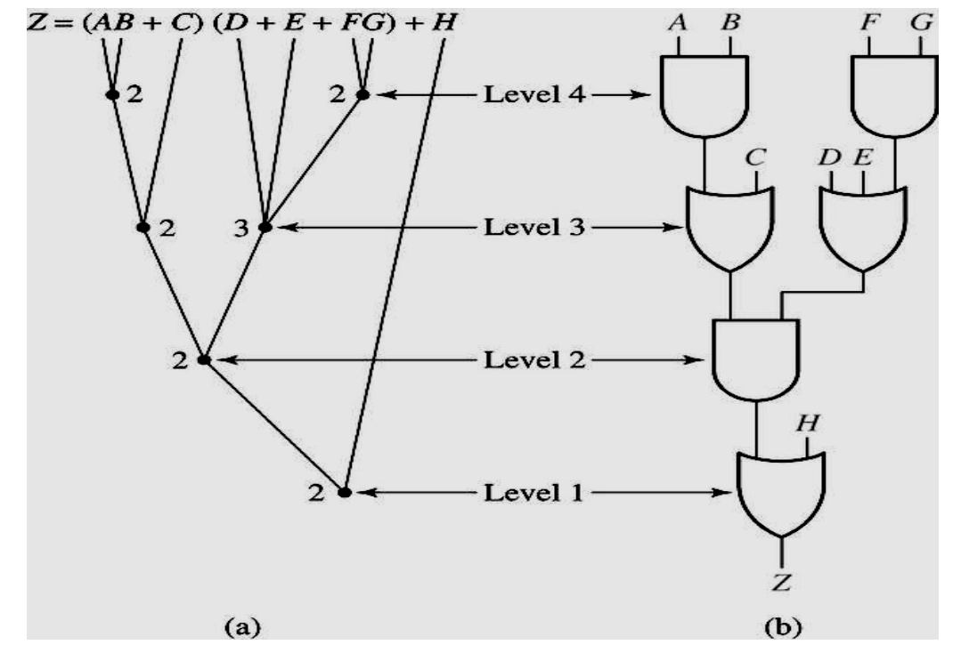
Multi-level Circuits
Chapter 2 - Part 1 <number>

Slide 102
Transformations
Factoring - finding a factored form from SOP or POS expression
  Algebraic - No use of axioms specific to Boolean algebra such as complements or idempotence
  Boolean - Uses axioms unique to Boolean algebra
Decomposition - expression of a function as a set of new functions
Chapter 2 - Part 2 <number>

Slide 103
Transformations (continued)
Substitution of G into F - expression function F as a function of G and some or all of its original variables
Elimination - Inverse of substitution
Extraction - decomposition applied to multiple functions simultaneously
Chapter 2 - Part 2 <number>

Slide 104
Transformation Examples
Algebraic Factoring
F = + B + ABC + AC G = 16
  Factoring:
F = ( + B ) + A (BC + C ) G = 16
  Factoring again:
F = ( B + ) + AC (B + ) G = 12
  Factoring again:
F = ( + AC) (B + ) G = 10
C
D
A
D
A
C
A
D
C
D
C
A
C
D
D
A
D
C
Chapter 2 - Part 2 <number>

Slide 105

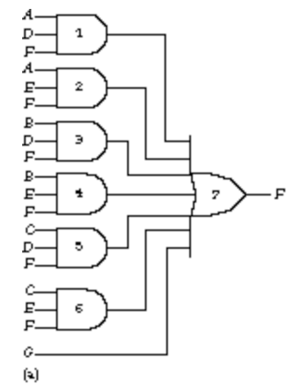
Example
Y =
The two-level network of AND and OR gates requires
six 3-input AND gates and one 7-input gate, a total of
seven gates and 19 literals.
Chapter 2 - Part 1 <number>
Notes:
http://moblie123.cm.nctu.edu.tw/104%20logical%20design/Unit%2007.pdf

Slide 106
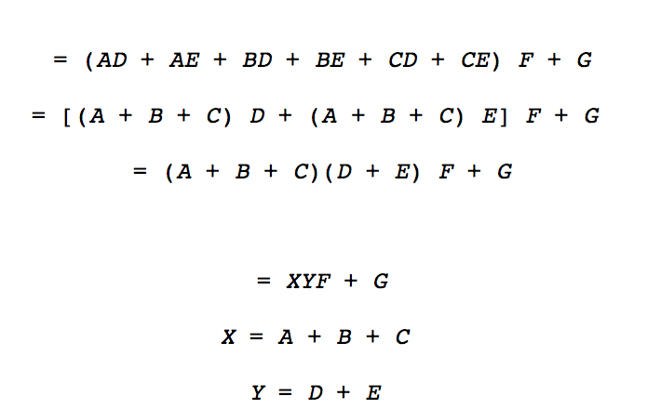
Optimization
Y =
Chapter 2 - Part 1 <number>
Notes:
http://www2.elo.utfsm.cl/~lsb/elo211/aplicaciones/katz/chapter3/chapter03.doc1.html

Slide 107
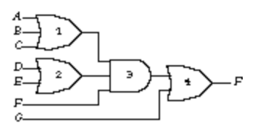
After optimization
The optimized function requires one 3-input OR gate, two 2-input OR gates,
and a 3-input AND gate, a total
of four gates and nine literals.
The intermediate functions X and Y
count as literals in the final expression for .
Chapter 2 - Part 1 <number>

Slide 108
Additional cost of Multi-level Optimization
You can significantly reduce the number of wires and gates needed to implement the function, but this implementation probably has worse delay because of the increased levels of logic. In general, multi-level implementations are more gate efficient than two-level implementations but have worse propagation delay.
Chapter 2 - Part 1 <number>

Slide 109
Component 2:
Combinational Logic
Part 1 – Gate Circuits and Boolean Equations
  Binary Logic and Gates
  Boolean Algebra
  Standard Forms
Part 2 – Circuit Optimization
  Two-Level Optimization
  Map Manipulation
  Multi-Level Circuit Optimization
Part 3 – Additional Gates and Circuits
  Other Gate Types
  Exclusive-OR Operator and Gates
  High-Impedance Outputs
Chapter 2 - Part 1 <number>

Slide 110
Other Gate Types
Why?
  Implementation feasibility and low cost
  Power in implementing Boolean functions
  Convenient conceptual representation
Gate classifications
  Primitive gate - a gate that can be described using a single primitive operation type (AND or OR) plus an optional inversion(s).
  Complex gate - a gate that requires more than one primitive operation type for its description
Primitive gates will be covered first
Chapter 2 - Part 3 <number>

Slide 111
Buffer
A buffer is a gate with the function F = X:
In terms of Boolean function, a buffer is the same as a connection!
So why use it?
  A buffer is an electronic amplifier used to improve circuit voltage levels and increase the speed of circuit operation.
X
F
Chapter 2 - Part 3 <number>

Slide 112
NAND Gate
The basic NAND gate has the following symbol, illustrated for three inputs:
  AND-Invert (NAND)
NAND represents NOT AND, i. e., the AND function with a NOT applied. The symbol shown is an AND-Invert. The small circle (“bubble”) represents the invert function.
X
Y
F
(
X
,
Y
,
Z
)
=
X
⋅
Y
⋅
Z
Z
Chapter 2 - Part 3 <number>

Slide 113
NAND Gates (continued)
Applying DeMorgan's Law gives Invert-OR (NAND)
This NAND symbol is called Invert-OR, since inputs are inverted and then ORed together.
AND-Invert and Invert-OR both represent the NAND gate. Having both makes visualization of circuit function easier.
A NAND gate with one input degenerates to an inverter.
X
Y
F
(
X
,
Y
,
Z
)
=
X
+
Y
+
Z
Z
Chapter 2 - Part 3 <number>

Slide 114
NOR Gate
The basic NOR gate has the following symbol, illustrated for three inputs:
  OR-Invert (NOR)
NOR represents NOT - OR, i. e., the OR function with a NOT applied. The symbol shown is an OR-Invert. The small circle (“bubble”) represents the invert function.
X
Y
F
(
X
,
Y
,
Z
)
=
X
+
Y
+
Z
Z
Chapter 2 - Part 3 <number>

Slide 115
NOR Gate (continued)
Applying DeMorgan's Law gives Invert-AND (NOR)
This NOR symbol is called Invert-AND, since inputs are inverted and then ANDed together.
OR-Invert and Invert-AND both represent the NOR gate. Having both makes visualization of circuit function easier.
A NOR gate with one input degenerates to an inverter.
X
Y
Z
Chapter 2 - Part 3 <number>

Slide 116
Exclusive OR/ Exclusive NOR
The eXclusive OR (XOR) function is an important Boolean function used extensively in logic circuits.
The XOR function may be;
  implemented directly as an electronic circuit (truly a gate) or
  implemented by interconnecting other gate types (used as a convenient representation)
The eXclusive NOR function is the complement of the XOR function
By our definition, XOR and XNOR gates are complex gates.
Chapter 2 - Part 3 <number>

Slide 117

Pushing Bubbles
DeMorgan
Chapter 2 - Part 1 <number>

Slide 118
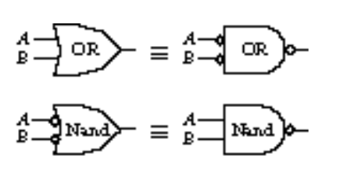
Pushing Bubbles (Continued)
Chapter 2 - Part 1 <number>

Slide 119
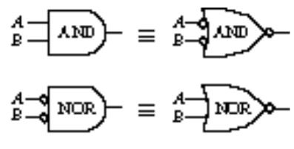
Pushing Bubbles (Continued)
Chapter 2 - Part 1 <number>

Slide 120


Example
Chapter 2 - Part 1 <number>

Slide 121
Exclusive OR/ Exclusive NOR
Uses for the XOR and XNOR gate include:
  Adders/subtractors/multipliers
  Counters/incrementers/decrementers
  Parity generators/checkers
Definitions
  The XOR function is:
  The eXclusive NOR (XNOR) function, otherwise
  known as equivalence is:
XOR and XNOR gates with more than two inputs represent odd and even functions.
X
⊕
Y
=
X
Y
+
X
Y
X
⊕
Y
=
X
Y
+
X
Y
Chapter 2 - Part 3 <number>

Slide 122
Truth Tables for XOR/XNOR
Operator Rules: XOR XNOR
The XOR function means:
X OR Y, but NOT BOTH
Why is the XNOR function also known as the equivalence function, denoted by the operator ≡?
X
Y
X
⊕
Y
X
Y
(X
⊕
Y)
or X
≡
Y
0
0
0
0
0
1
0
1
1
0
1
0
1
0
1
1
0
0
1
1
0
1
1
1
Chapter 2 - Part 3 <number>
Notes:
Because it is defined as X Y + X’ Y’ that equals 1 if and only if X = Y implying X is equivalent to Y.

Slide 123
XOR/XNOR (Continued)
The XOR function can be extended to 3 or more variables. For more than 2 variables, it is called an odd function or modulo 2 sum (Mod 2 sum) :
The complement of the odd function is the even function.
The XOR identities:
X
⊕
Y
⊕
Z
=
X
Y
Z
+
X
Y
Z
+
X
Y
Z
+
X
Y
Z
X
⊕
0
=
X
X
⊕
1
=
X
X
⊕
X
=
0
X
⊕
X
=
1
X
⊕
Y
=
Y
⊕
X
(
X
⊕
Y
)
⊕
Z
=
X
⊕
(
Y
⊕
Z
)
=
X
⊕
Y
⊕
Z
Chapter 2 - Part 3 <number>
Notes:
Odd function, the odd number of the true values will be one

Slide 124
Symbols For XOR and XNOR
XOR symbol:
XNOR symbol:
Chapter 2 - Part 3 <number>

Slide 125
XOR Implementations
The simple SOP implementation uses the following structure:
A NAND only implementation is:
X
X
Y
Y
X
X
Y
Y
Chapter 2 - Part 3 <number>

Slide 126
Odd and Even Functions
The odd and even functions on a K-map form “checkerboard” patterns.
The 1s of an odd function correspond to minterms having an index with an odd number of 1s.
The 1s of an even function correspond to minterms having an index with an even number of 1s.
Implementation of odd and even functions for greater than 4 variables as a two-level circuit is difficult, so we use “trees” made up of :
  2-input XOR or XNORs
  3- or 4-input odd or even functions
Chapter 2 - Part 3 <number>

Slide 127
Example: Odd Function Implementation
+
Design a 3-input odd function F = X Y Z
with 2-input XOR gates
Factoring, F = (X Y) Z
The circuit:
+
+
+
X
Y
F
Z
Chapter 2 - Part 3 <number>

Slide 128
Example: Even Function Implementation
+
Design a 4-input even function F = W X Y Z
with 2-input XOR and XNOR gates
Factoring, F = (W X) (Y Z)
The circuit:
+
+
+
+
+
W
X
F
Y
Z
Chapter 2 - Part 3 <number>

Slide 129
Parity Generators and Checkers
In Chapter 1, a parity bit added to n-bit code to produce an n + 1 bit code:
  Add odd parity bit to generate code words with even parity
  Add even parity bit to generate code words with odd parity
  Use odd parity circuit to check code words with even parity
  Use even parity circuit to check code words with odd parity
Example: n = 3. Generate even
parity code words of length 4 with
odd parity generator:
Check even parity code words of
length 4 with odd parity checker:
Operation: (X,Y,Z) = (0,0,1) gives
(X,Y,Z,P) = (0,0,1,1) and E = 0.
If Y changes from 0 to 1 between
generator and checker, then E = 1 indicates an error.
X
Y
P
Z
X
Y
E
Z
P
Chapter 2 - Part 3 <number>
Notes:
Even parity code generator (0011) and

